Slide 1
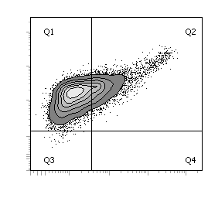
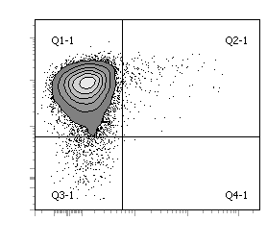
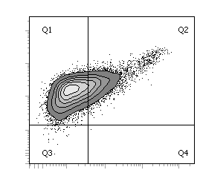
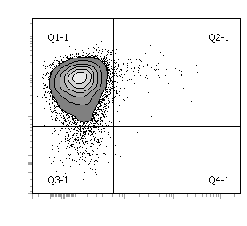

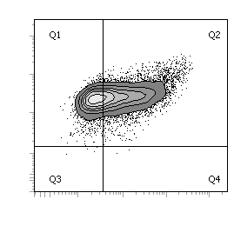
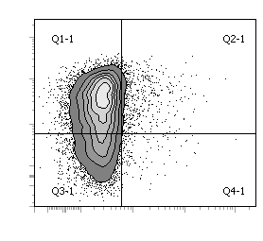
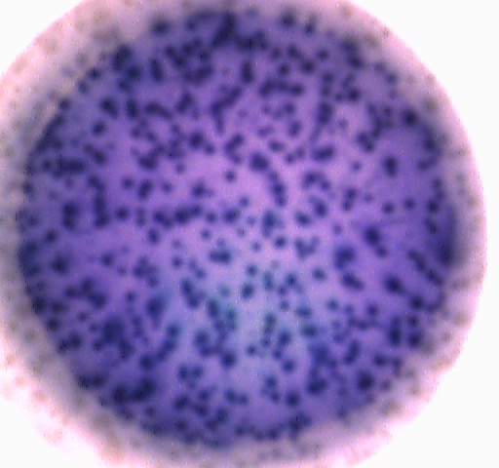
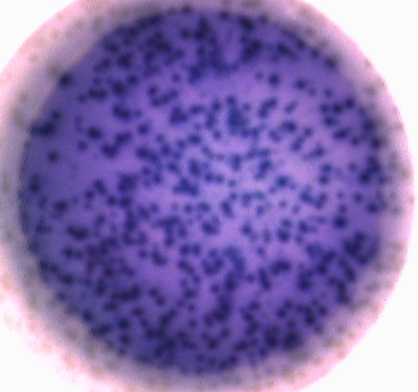
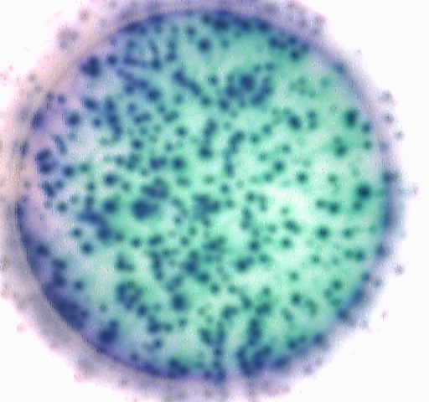
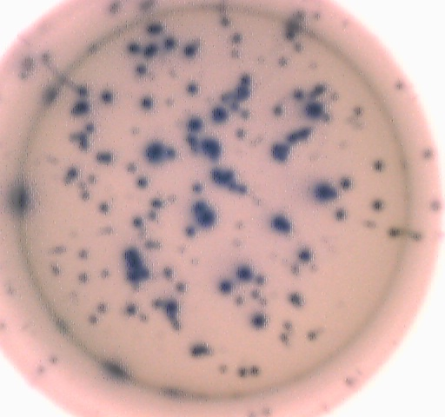
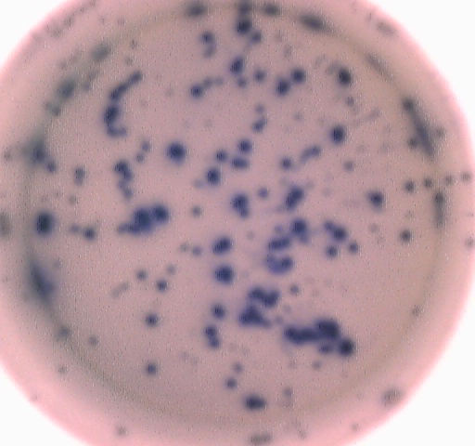
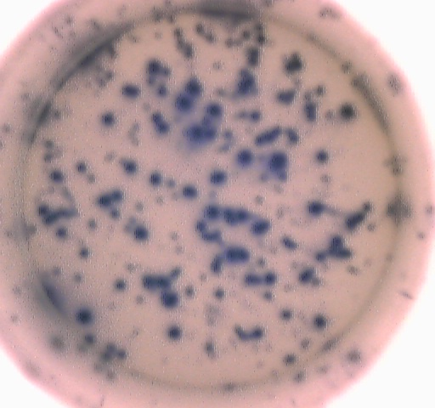
Supplemental Figure 10
(D)
(A)
Day3
+24h
+48h
+72h
-
+
-
+
-
+
69.0
30.6
94.5
1.7
H3
K9me2
DMSO
DMSO
DMSO
Std
H3
3.8
69.7
29.9
94.7
1.5
(B)
Day3
+24h
+48h
+72h
DMSO
-
+
-
+
-
+
DMSO
DMSO
DMSO
3.7
LC3A/B-I
LC3A/B-II
39.3
60.7
69.4
5.0
UNC
0638
H3
CD19
CD38
24.6
(C)
(E)
CD20
CD138
Std
G5
24h
DMSO
G4
24h
1
G3
2
G2
3
4
UNC0638
5
G1
Std
G6
48h
DMSO
G5
48h
% Cells/Generation
G4
1
G3
2
3
UNC0638
4
G2
5
6
G1
Std
*
G7
72h
DMSO
G6
72h
1
G5
2
G4
3
UNC0638
4
5
G3
6
7
G2
Cyto-ID
SSC
Std
G1
CFSE
DMSO
UNC0638
(F)
Std
DMSO
UNC0638
Std
DMSO
IgM
ASCs/well
UNC0638
IgG
IgM
IgG
IgM
IgG
IgM
IgG

