Slide 1
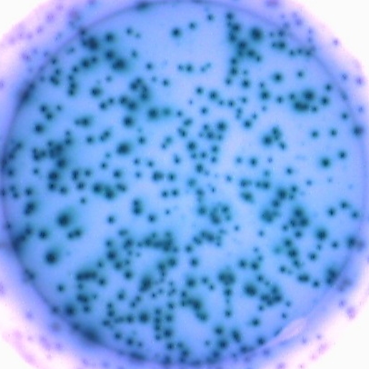
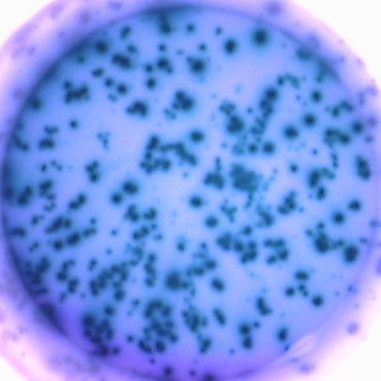
Supplemental Figure 3
A
C
B
D0
Iso
D0
D3
ABC
D3
D6
CD30
D4
CD30 ΔMFI
D5
Day
Percentage
PB
D6
CD19
CD38
Day
B
CD20
CD138
CFSE
D
2000 D6 cells/well
IgM
n= 438
IgG
n= 475
Percentage
Day

